Slide 1

BETWEEN HEALTH AND HARM Topic Modeling of Discussions on Weight Loss and Eating Disorders
Yilin Xu
MACS 30100
March 2025
Notes:
My name is Yilin. In this video, I will present my project: Between health and harm: topic modeling of Discussions on Weight Loss and Eating Disorders

Slide 2
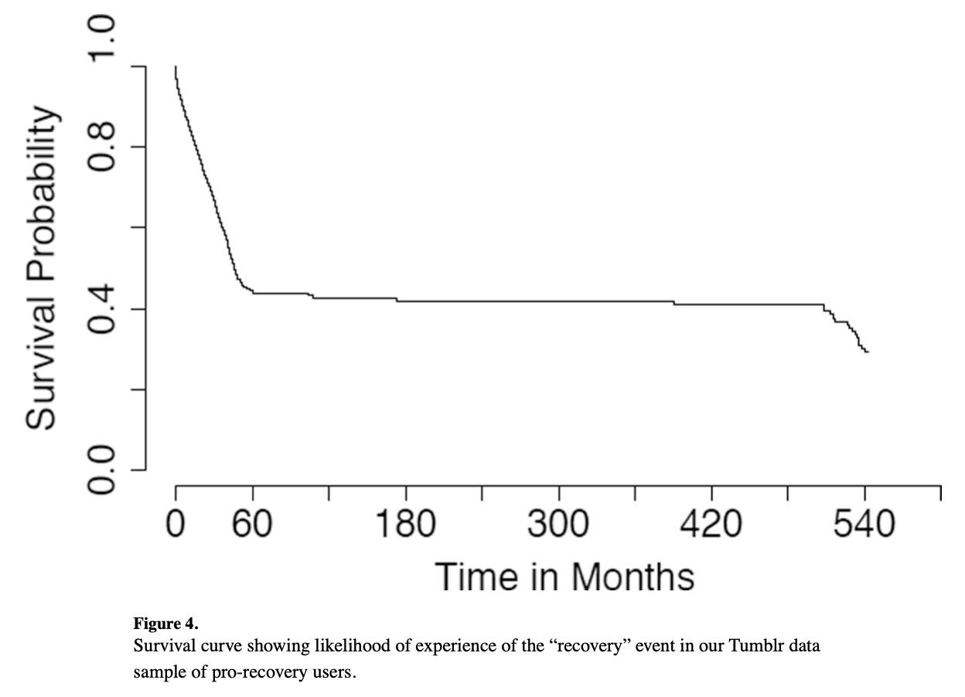
Prior Research
Chancellor, Stevie, Tanushree Mitra, and Munmun De Choudhury. 2016. “Recovery amid Pro-Anorexia.” Proceedings of the 2016 CHI Conference on Human Factors in Computing Systems, May, 2111–23. doi:10.1145/2858036.2858246.
survival analysis using text processing and manual annotations;
over 10,000 Tumblr users and over 68 million posts;
prospective factors associated with the likelihood of recovery: greater social engagement, lowered self-attentional focus, and increased positive affect;
online social platforms may act as support and resistance for ED patients because of the large and vocal presence of anti-recovery groups.
Notes:
There have been various prior research on ED using text analysis. Chancellor et al. conducted survival analysis on ED patients using text features of their posts on Tumblr. They discovered that higher likelihood of recovery is associated with greater social engagement, lower self-attentional focus and increased positive affect. They also identified significant of peers online as a form of support and as a form of resistance to recovery.

Slide 3
Prior Research
Moessner, Markus, Johannes Feldhege, Markus Wolf, and Stephanie Bauer. 2018. “Analyzing Big Data in Social Media: Text and Network Analyses of an Eating Disorder Forum.” International Journal of Eating Disorders 51 (7): 656–67. doi:10.1002/eat.22878.
computerized content analysis and network analysis on the proed forum on Reddit;
Importance of “feedback and social support” from peers.
Wang, Tao, Markus Brede, Antonella Ianni, and Emmanouil Mentzakis. 2017. “Detecting and Characterizing Eating-Disorder Communities on Social Media.” Proceedings of the Tenth ACM International Conference on Web Search and Data Mining, February, 91–100. doi:10.1145/3018661.3018706.
social status, behavioral patterns, and psychometric properties;
network analysis on homophily of online ED communities.
pro-ana, anti-ana, and pro-recovery prevalence differences, predominantly female users;
a source of support and as a potential risk for vulnerable individuals;
need for intervention strategies that balance content moderation with the preservation of positive peer support networks.
Branley, D. B., & Covey, J. (2017). Pro-ana versus pro-recovery: A content analytic comparison of social media users’ communication about eating disorders on Twitter and Tumblr. Frontiers in Psychology, 8. doi:10.3389/fpsyg.2017.01356.
Notes:
Wang et al. and Moessner et al. both identified homophily phenomenon through network analysis of online ED communities on different platforms. Branley and Covey identifies the need for intervention strategies that balance content moderation with the preservation of positive peer support networks.

Slide 4

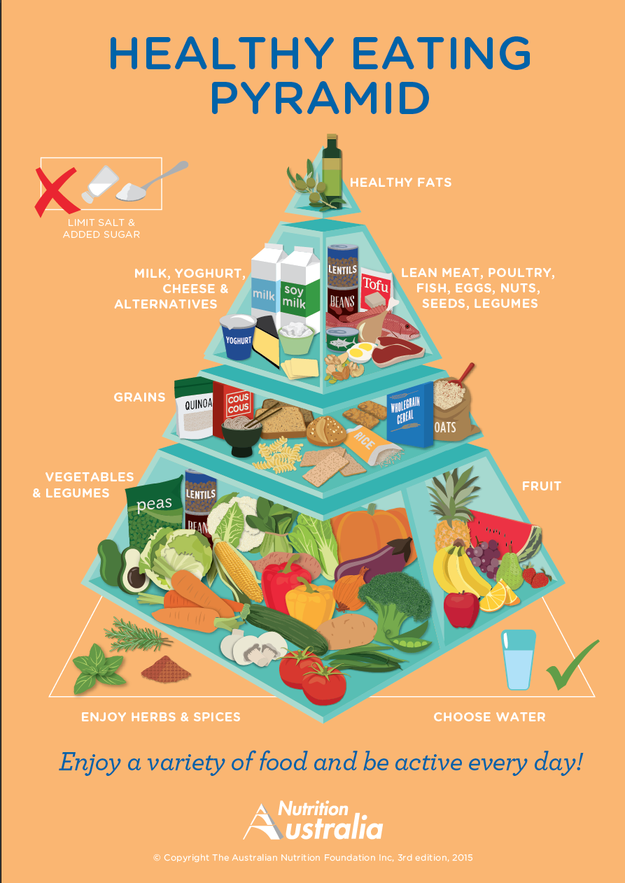
Research Question & Motivation
RQ:
What are the key themes in discussions around weight loss and eating disorder experiences within online communities? How distinct are the key themes in the two broad categories?
Motivation:
uncover hidden themes and issues;
complex, overlapping nature of Reddit data;
significance of peer support
cultural, societal perceptions and response about mental health;
helping design more targeted interventions and resources.
Notes:
To design better ED intervention strategies, I propose the following research questions:
What are the key themes in discussions around weight loss and eating disorder experiences within online communities? How distinct are the key themes in the two broad categories?
By answering these questions, we should be able to uncover hidden themes and issues to distinguish normal discussions about weight loss and discussions about restrictive eating behavior which is likely to evolve into more serious mental health problems. The results will help design more targeted interventions and resources
Reddit offers an open, unfiltered platform where individuals share personal experiences related to weight loss and eating disorders, making it an ideal source of authentic data.

Slide 5
MACHINE LEARNING TASK
EDA
LDA
BERTopic
Description
Probabilistic
Embedding
Logistic Regression(Labeled)
K-Means Clustering
Sentiment Analysis(VADER + roberta)
Stemming vs. Lemmatization
Unigram vs. Bigram
Step-by-Step Breakdown
Notes:
Topic modeling doesn't require predefined categories, making it suitable for the complex, overlapping nature of Reddit data.
I explore traditional probabilistic LDA and Bertopic methods.

Slide 6



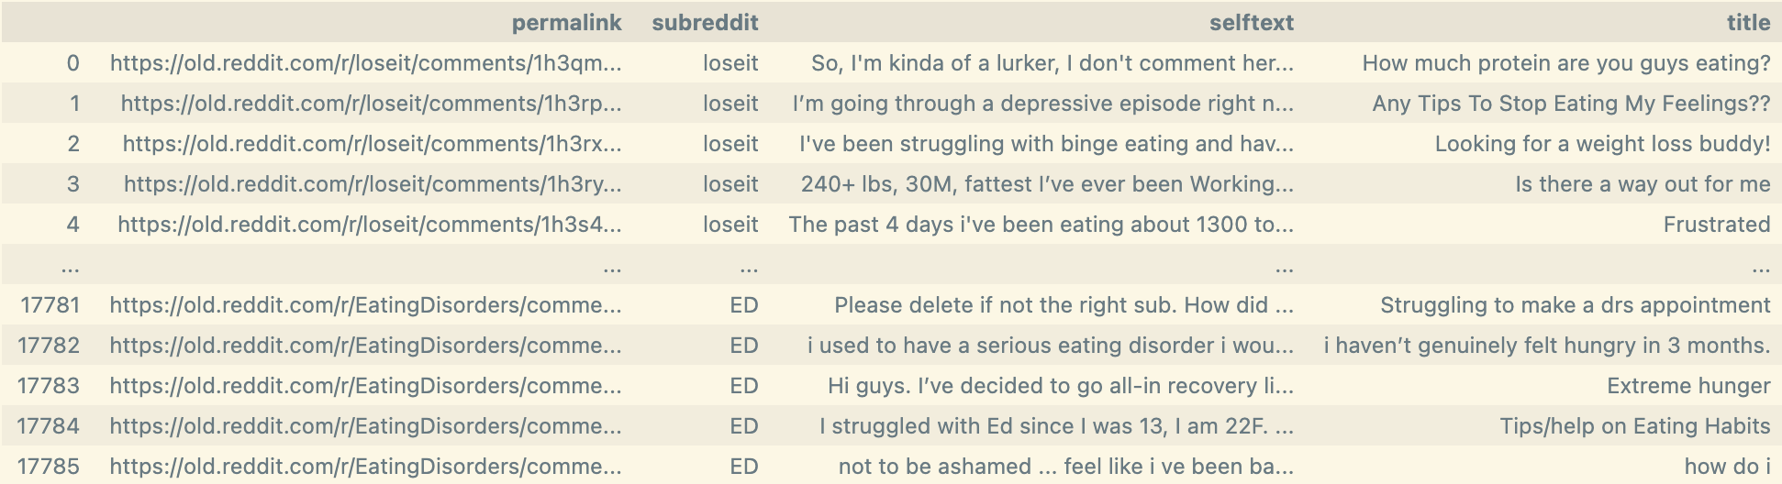
DATA: REDDIT(downloaded via Arctic Shift)
33 %
66 %
100 %
r/loseit
r/EatingDisorders
r/EDAnonymous
permalink, subreddit, selftext, title
.unique()
.drop_duplicates()
Size: 26,019 ->15, 264
2024/12/01 - 2025/03/01
Notes:
We download data from three subreddits over a span of three months. We drop duplicated and short entries. We use approximately 15,000 posts as our text data.

Slide 7
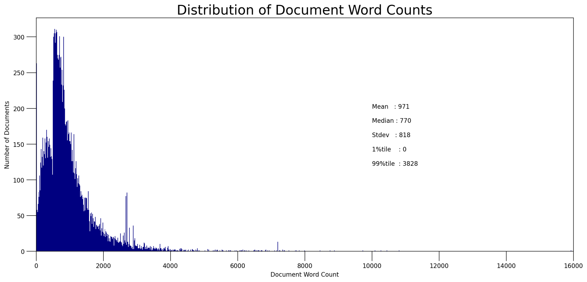
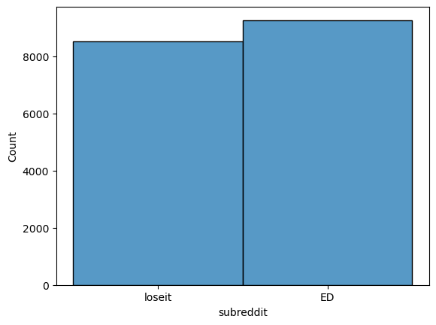
DATA: REDDIT(downloaded via Arctic Shift)
Combine posts from the two ED-related subreddits into one:
data['subreddit'] = np.where(data['subreddit'] != 'loseit', 'ED', data['subreddit'])

Slide 8
Exploratory Data Analysis
Logistic Regression
Content
How are the posts distributed? How complex are the contents?
K-Means Clustering
EDA
VADER
Sentiment
What is the sentiment profile of the posts like?
Multi-Label Sentiment
Notes:
For EDA, we explore text content and sentiment.

Slide 9
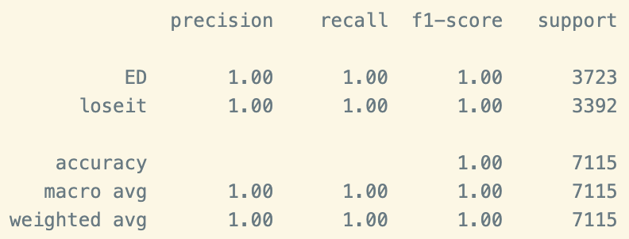
EDA: Content
⚠️26,790 Features!!!
Wow! The results are perfect. This means we are facing overfitting issue. We can check this by recreate the models using the best parameters given by grid search and check the number of coefficients the logistic regression model has.
Notes:
First, we used grid search for logistic regression. The parameters we find indicates that when tokens of df lower than 50% are used, we get perfect results. This suggests we have a lot of common tokens for texts from each category.

Slide 10
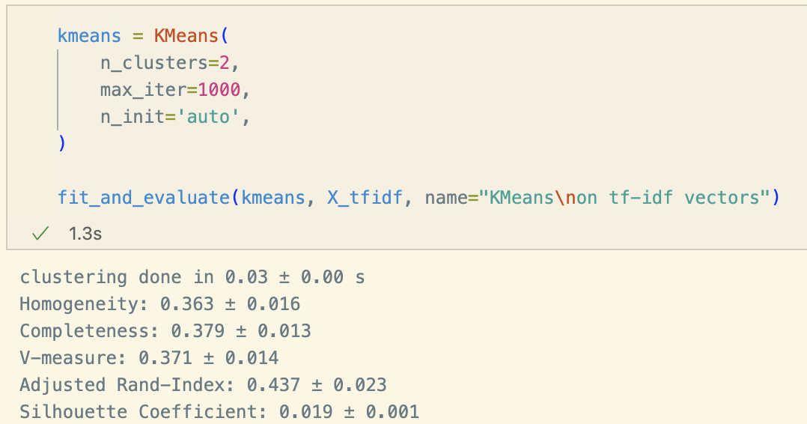
EDA: Content
Weak clustering results for 2 clusters = Spread Out Data;
HENCE,
We aspire to detect smaller topics and themes
Notes:
K-Means Clustering results suggests that our data is spread out across clusters.

Slide 11
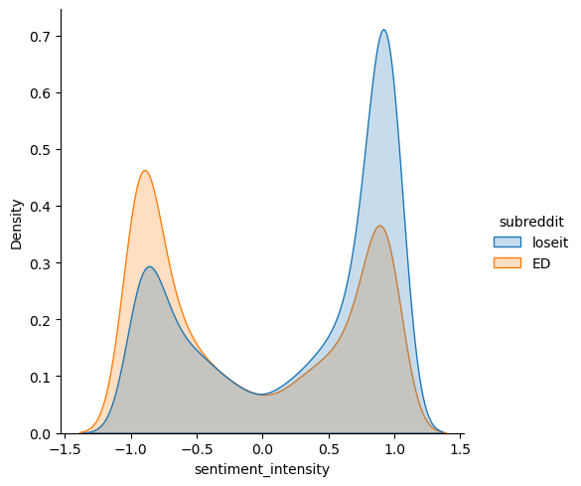
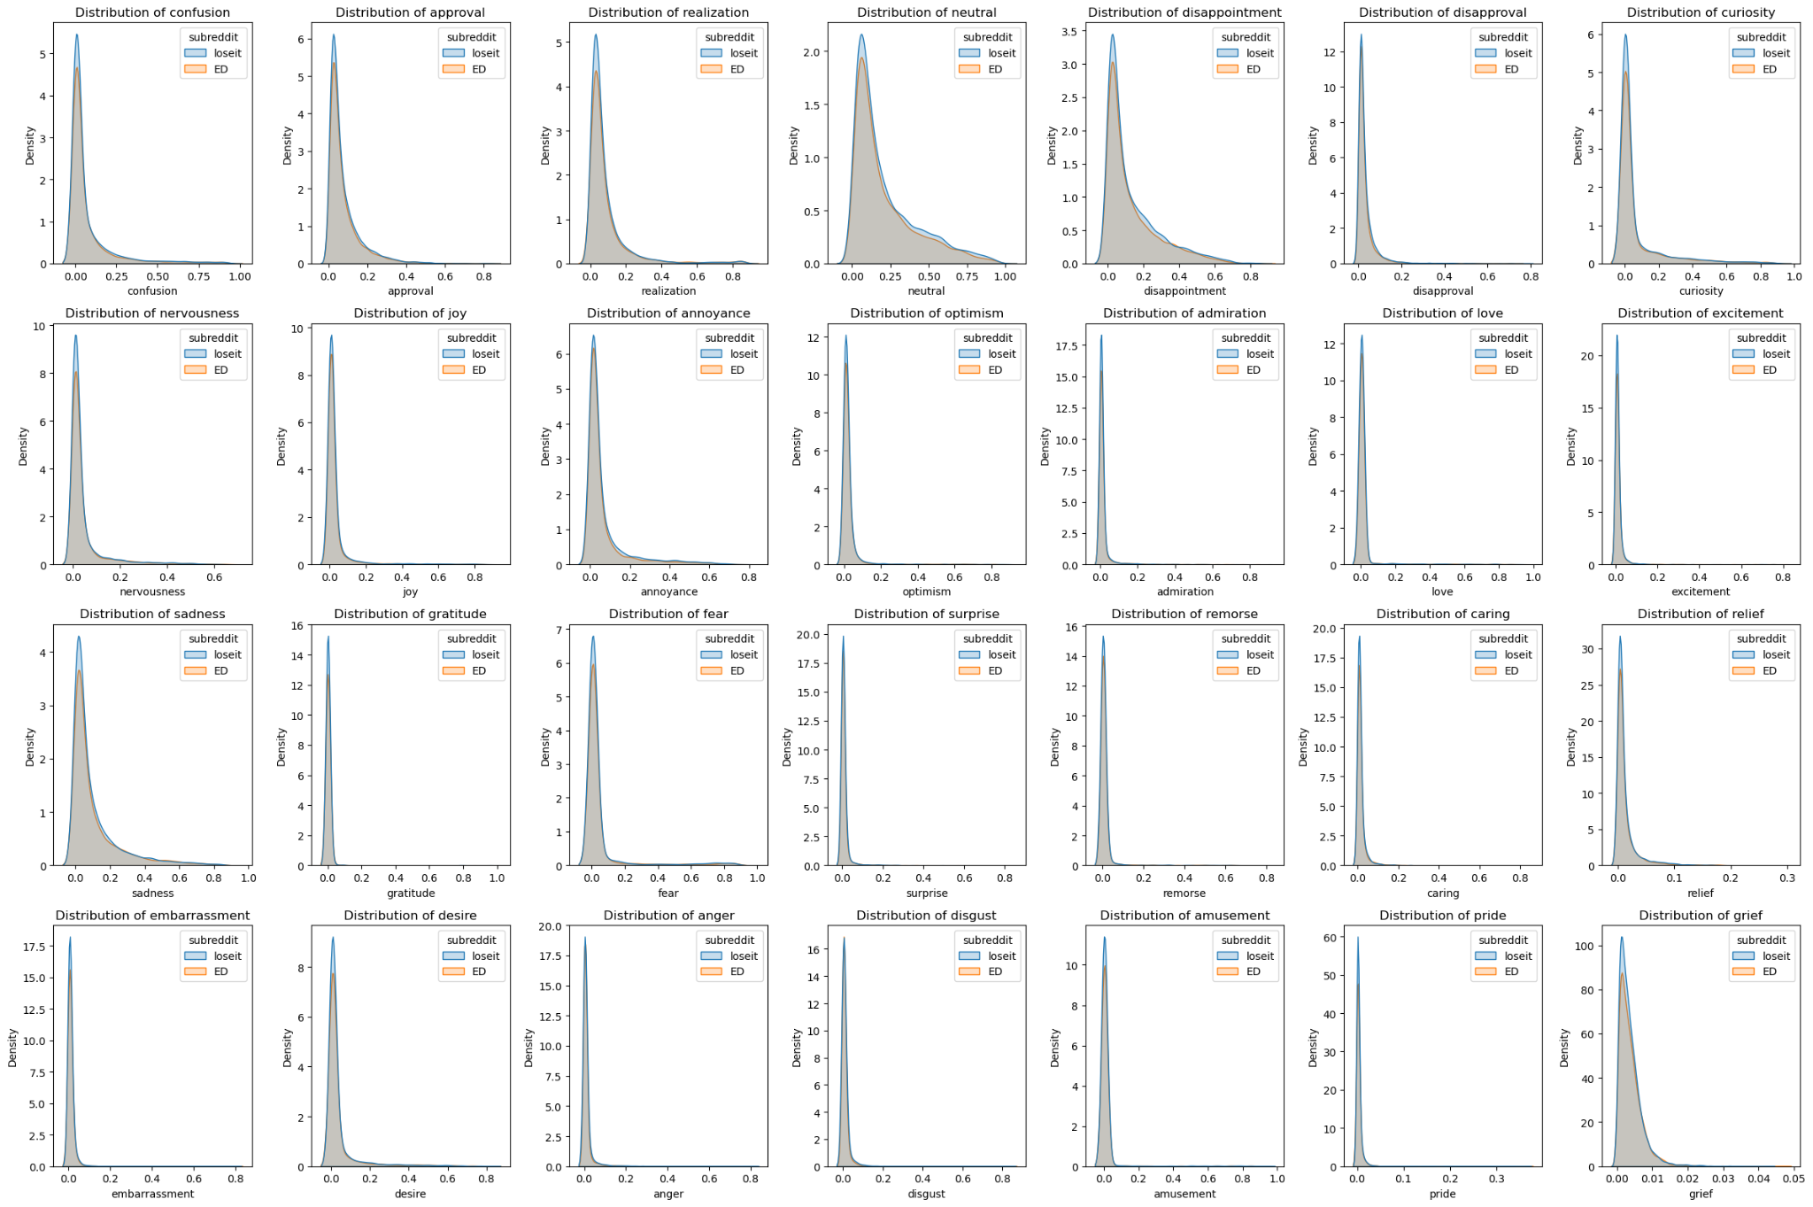
EDA: Sentiment - VADER vs. Multi Sentiment
Notes:
We used VADER and a Multi-Sentiment model for sentiment analysis. Both categories seem to have polarized distribution of sentiments as we observe a 'valley' centered at 0.0 for neutral sentiment for both.

Slide 12

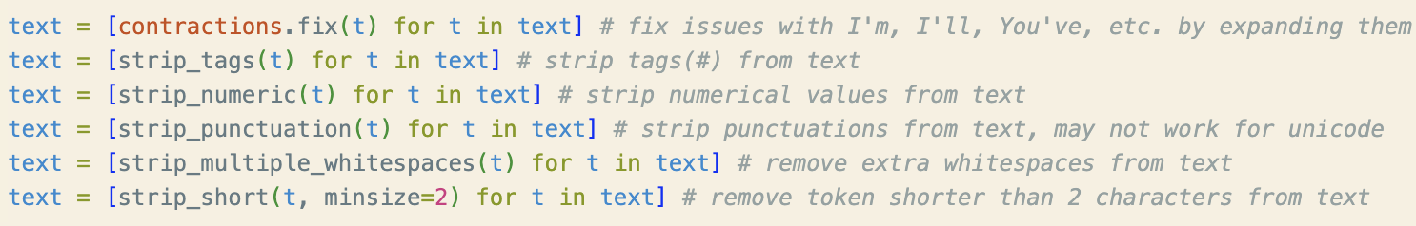
LDA with Gensim: Text Preprocessing
Stemming vs. Lemmatization?
Unigram vs. Bigram?
Expand contractions, strip tags, numerics, punctuations, excess whitespaces, tokens shorter than 2.
Notes:
Moving on to LDA. After text preprocessing. I face the question of which techniques I should use: stemming or lemmatization? should I include bigrams.

Slide 13
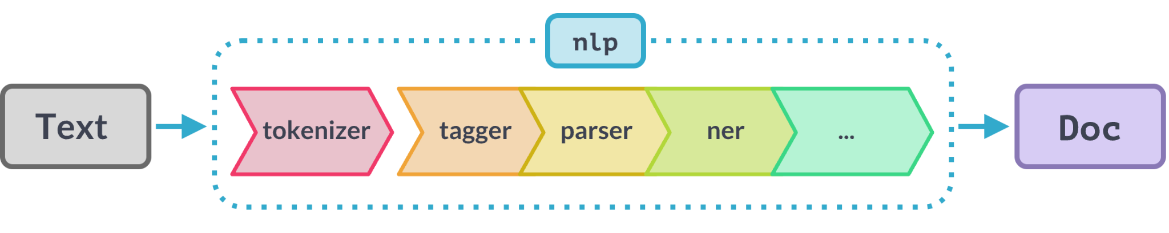

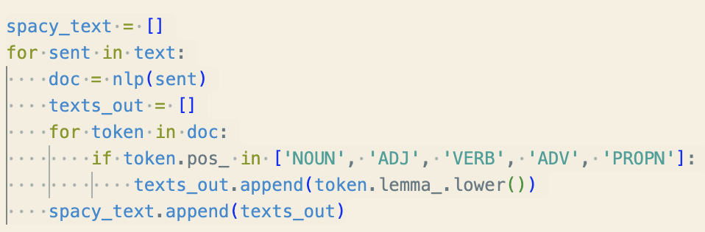
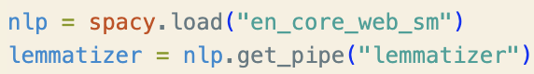
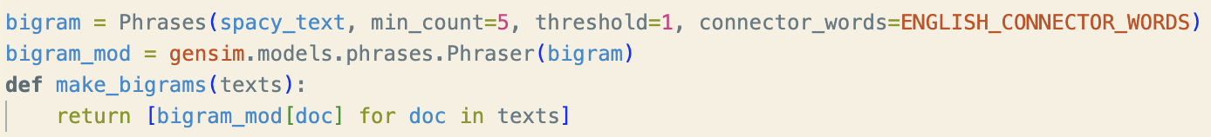
LDA with Gensim: Text Preprocessing
Stemming
Lemmatization
Lemmatization + Bigram
Notes:
I decided to try three methods of text tokenization: stemming, lemmatization, and lemmatization plus bigram. I imported lemmatizer pipeline from spacy and used gensim's Phrases object to construct a bigram model to build bigrams.

Slide 14
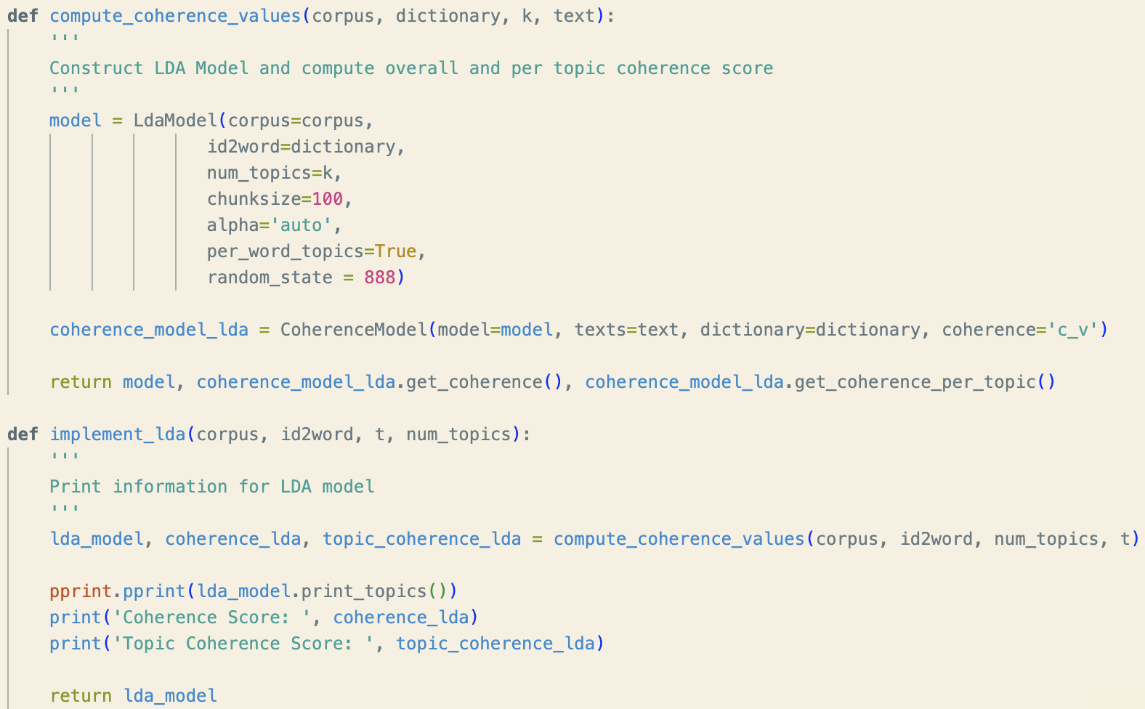
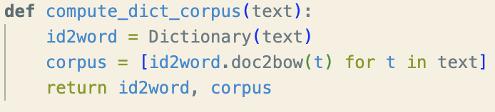
LDA with Gensim: Constructing
Notes:
Next, I constructed the id to word dictionary and corpus.

Slide 15
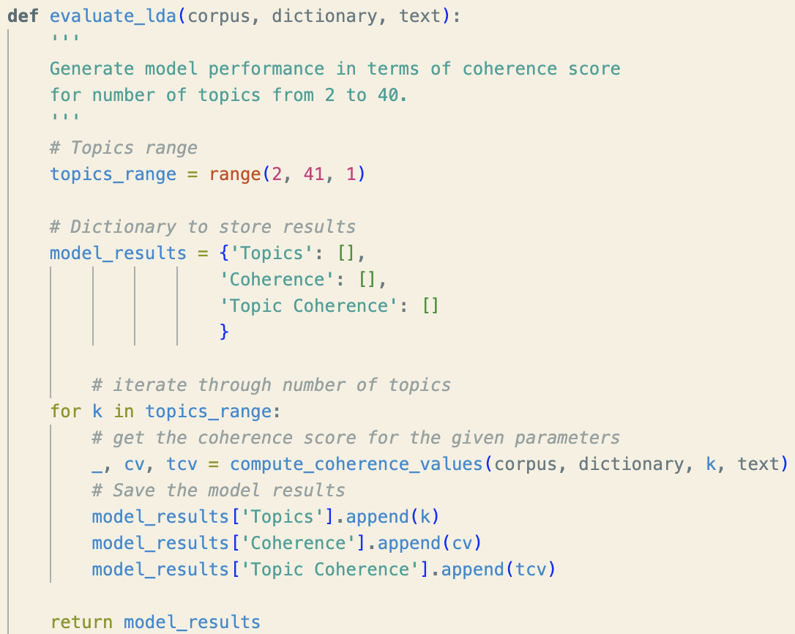
LDA with Gensim: Evaluating
Notes:
I evaluate the results using coherence metric c_v. Different topic numbers impact final outcomes. So, I tried topic numbers from 2 to 40.

Slide 16
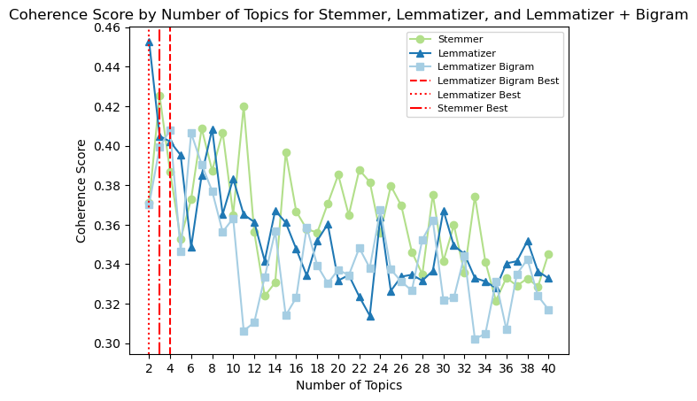
LDA with Gensim: Evaluating
Notes:
I plotted average coherence score trend for the three text tokenization methods.

Slide 17
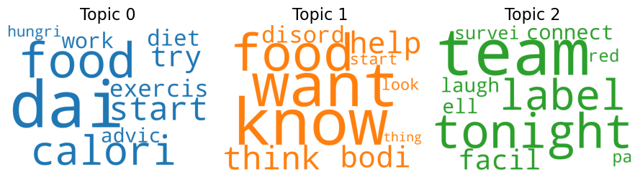
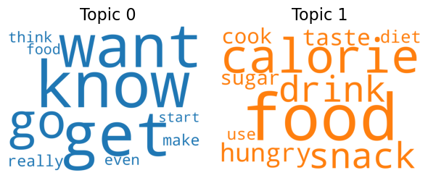
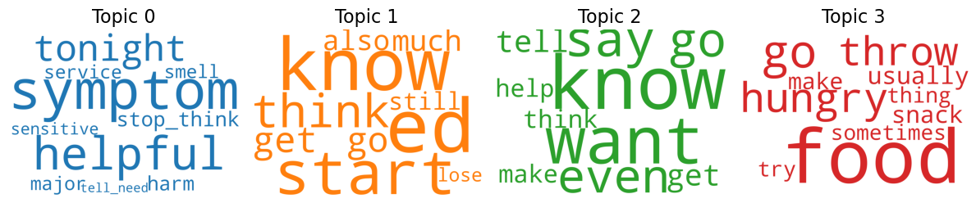
LDA with Gensim: Viz & Interpretation
01
Stemming
02
Lemmatization
03
Lemmatization
& Bigram
* pyLDAvis hyperlinked
Notes:
The best coherence scores are relatively close to each other. Some words appear in multiple topics in one model.

Slide 18
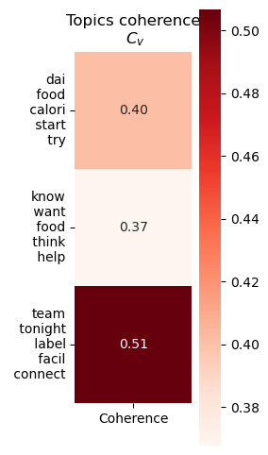
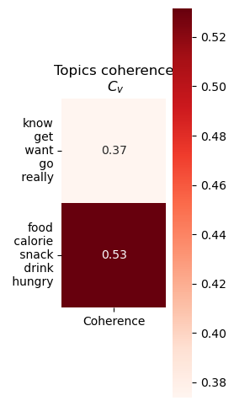
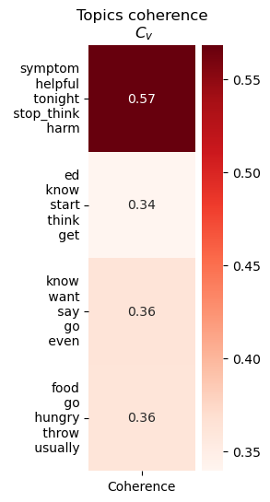
LDA with Gensim: Viz & Interpretation
Stemming
Lemmatization
Lemmatization & Bigram
Notes:
All three methods gives score lower than 0.5. Our results are better than expected as we only removed limited stopwords.

Slide 19
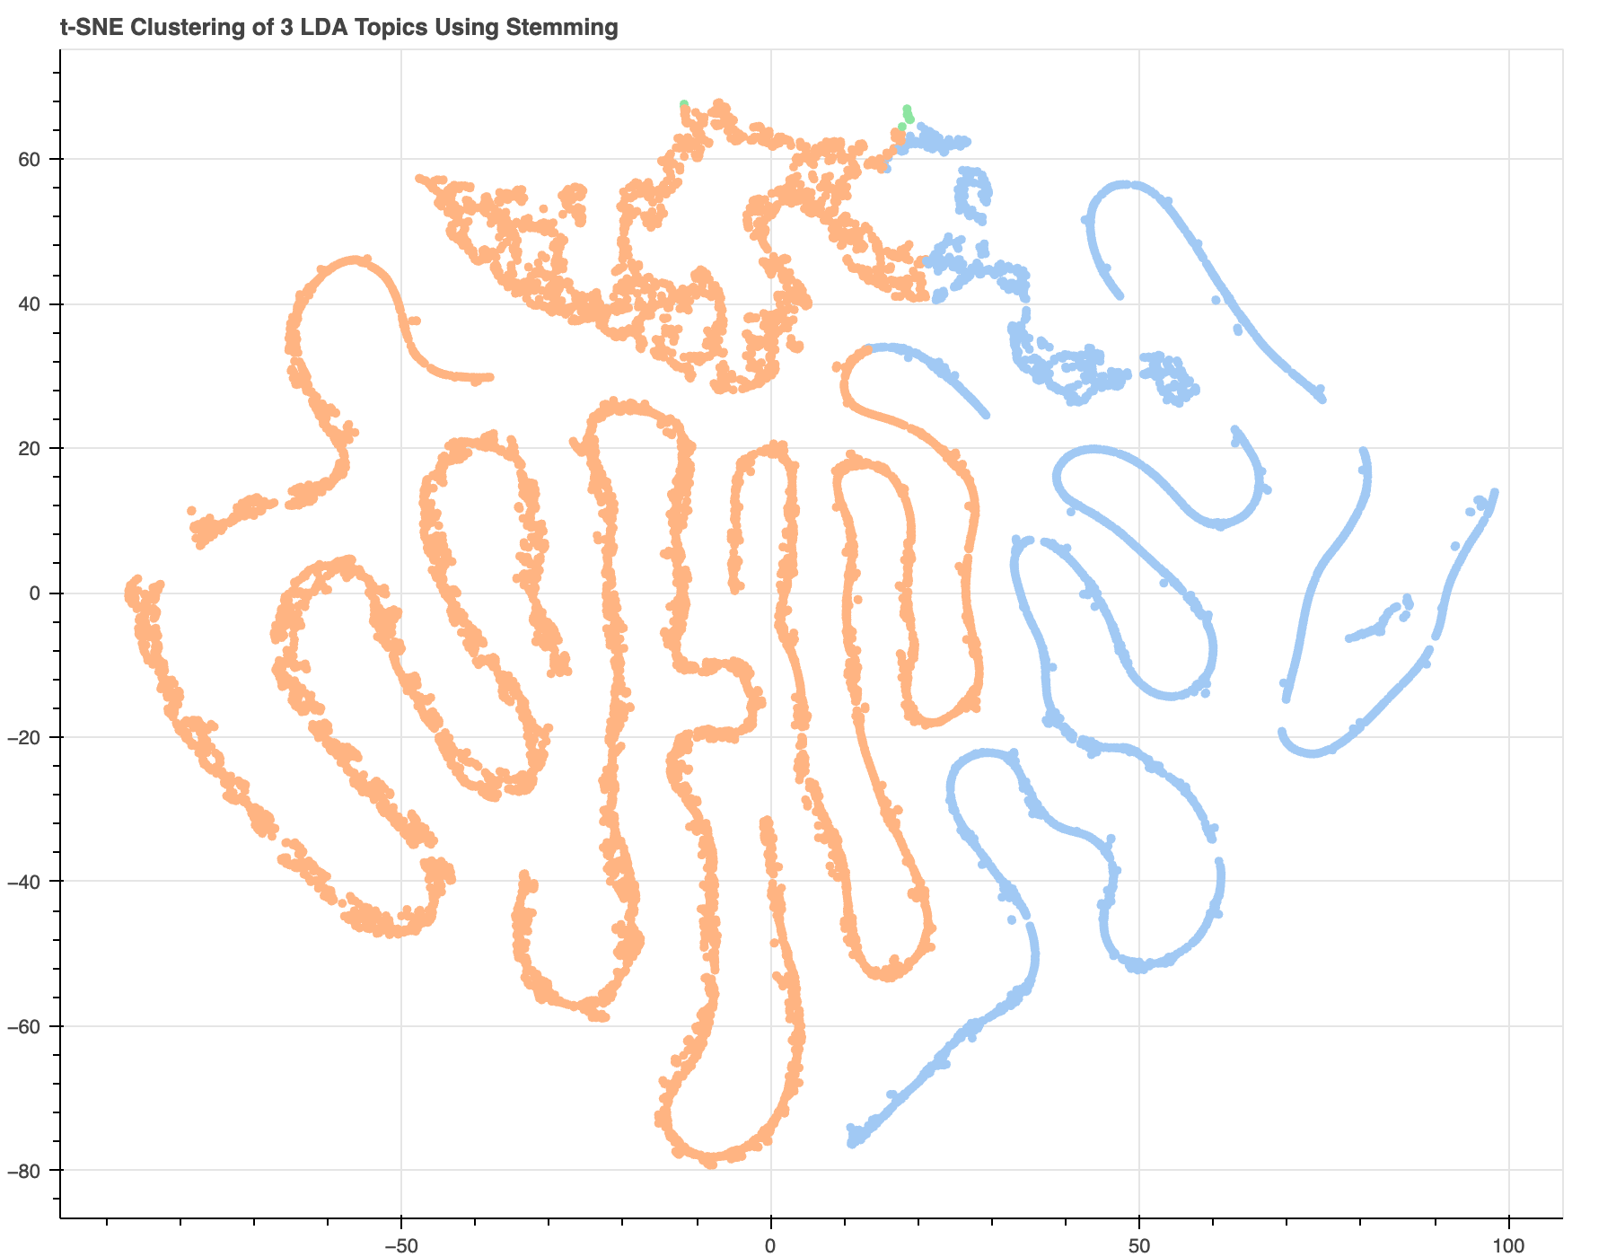
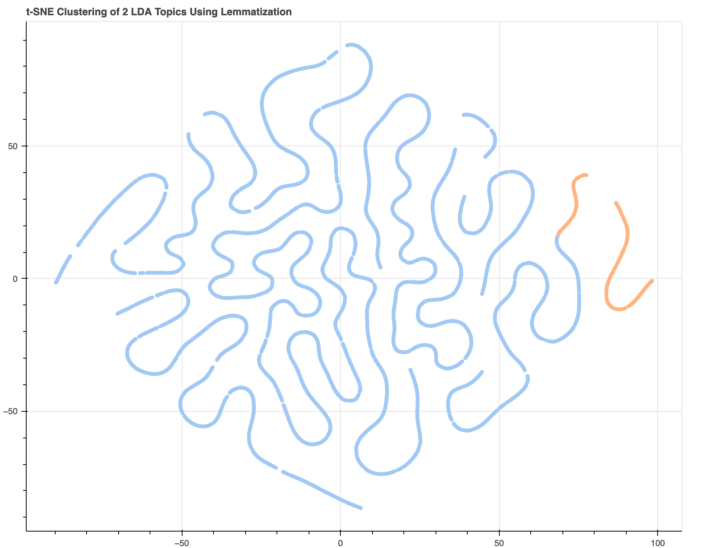
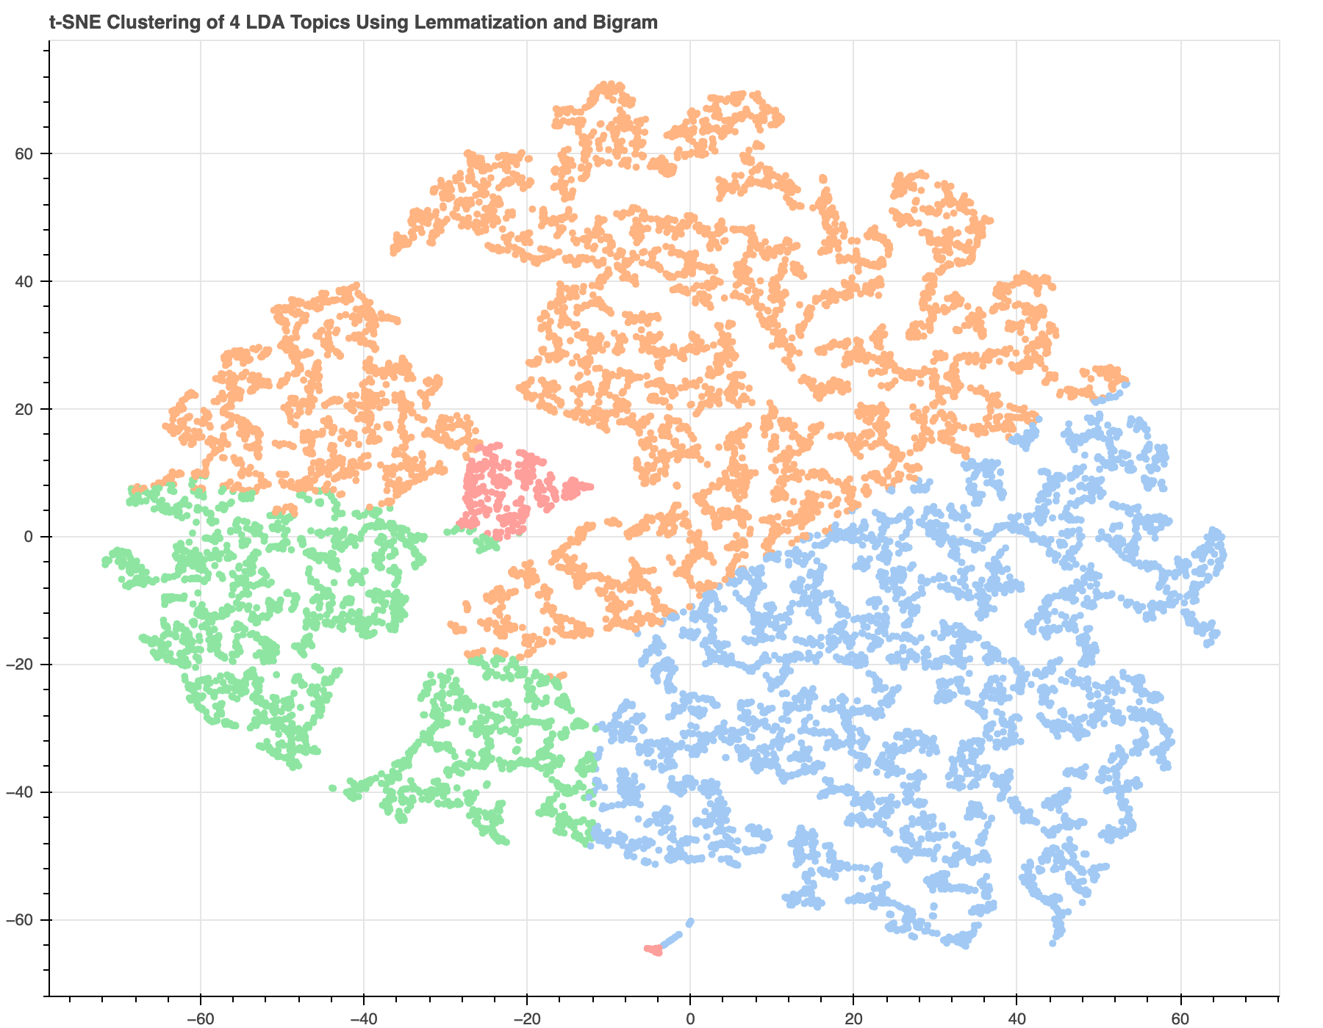
LDA with Gensim: Viz & Interpretation
Stemming
Lemmatization
Lemmatization & Bigram
Notes:
For tSNA clustering visualization, we observe curves of condensed dots for the Stemming Model and Lemmatization Model and much more scattered points for Lemmatization + Bigram Model. The spirals are likely a result of low-dimensional representation of high-dimensional data which optimizes on preserving local structure. We observe well-seperated clusters in all three cases, especially Lemmatization + Bigram Model, this suggests the assignment of documents are relatively distinct and the models are producing coherent topics.

Slide 20


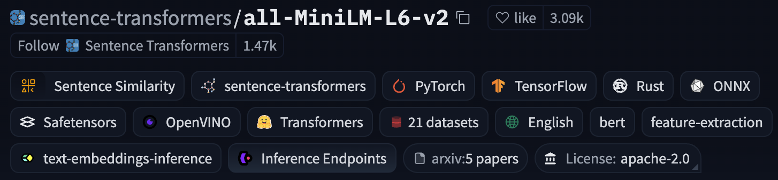
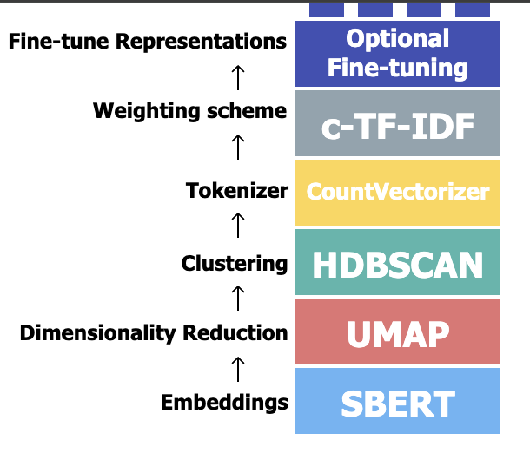
BERTopic: Embedding
(15264, 384): 384 dimensions
Notes:
Next, we explore BERTopic model. The frist step is embedding. The sentence transformer model I used created 384 dimensions.

Slide 21

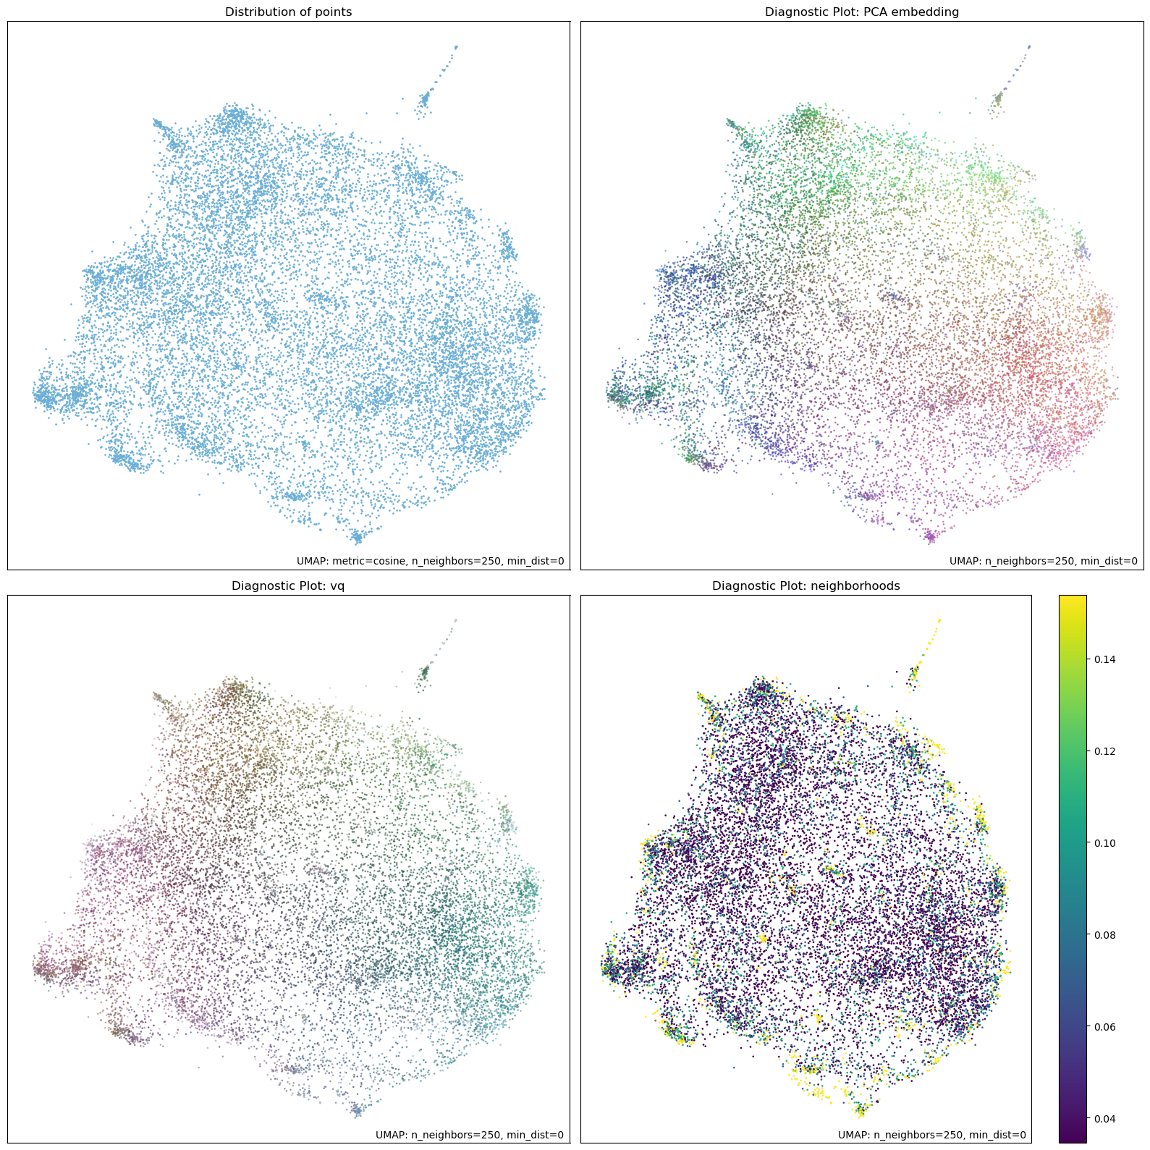
BERTopic: Dimension Reduction
Notes:
Next, we want to reduce the dimensions with UMAP. The visualization shows distribution of documents when we reduce dimension to 2. We hardly see any distinctions.

Slide 22
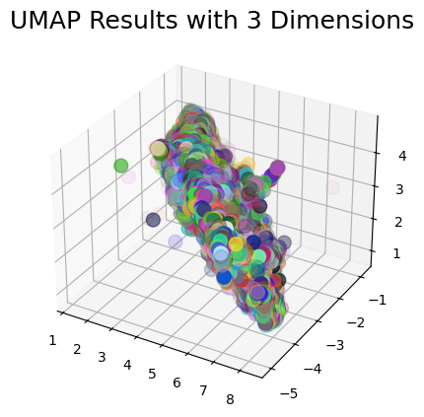
BERTopic: Dimension Reduction
Notes:
Similarly, when we reduce dimension to 3, we also have highly congregated block of documents in 3d space. Apparently, we need to set a higher number for dimensions to keep.

Slide 23
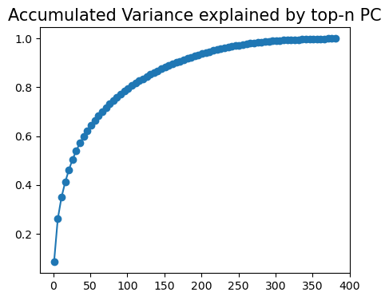
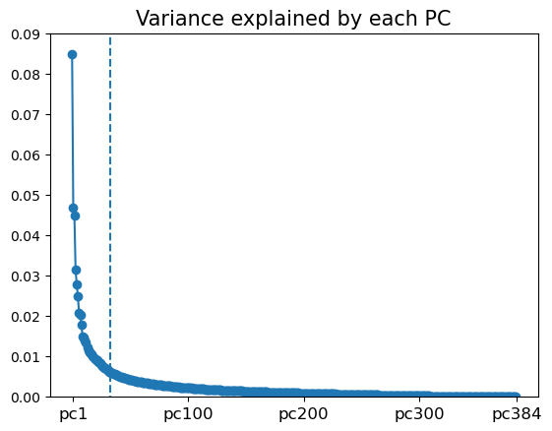
Q: How to find Ideal Number of Dimensions?
A: PCA!
Notes:
How to we find the number? With PCA. I implemented PCA and plotted the point at which the additional variance explained by each PC by number of PC's gradient is smallest. The result shows that 33 PCs is the ideal number to use.

Slide 24

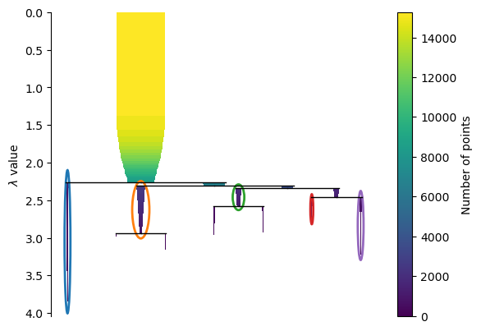
BERTopic: Clustering
Notes:
Next, we can do hierarchical density-based clustering. I used min cluster size of 250 and min samples of 125. The figure shows the clusters identified with these parameters.

Slide 25
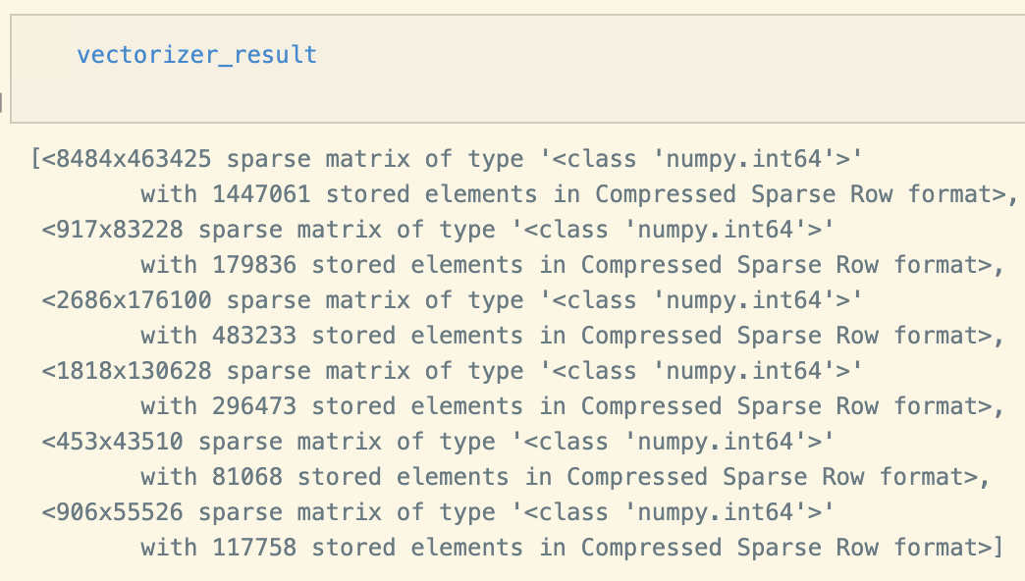
BERTopic: Tokenizer
Notes:
I build tokenizer model for each cluster.

Slide 26
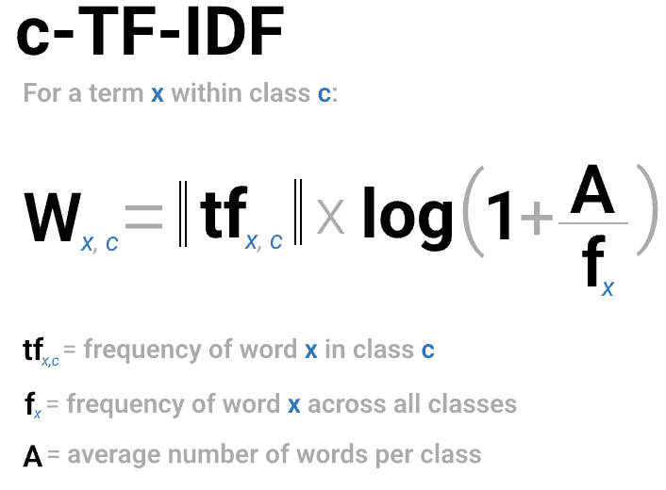
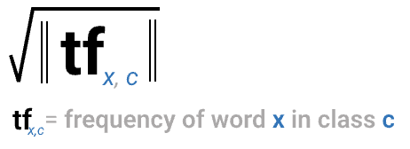
BERTopic: Class-Based TF-IDF
Notes:
And I used class-based tf-idf to generate words that are representative of each cluster but not frequently appearing. This will provide better interpretability of each cluster.

Slide 27
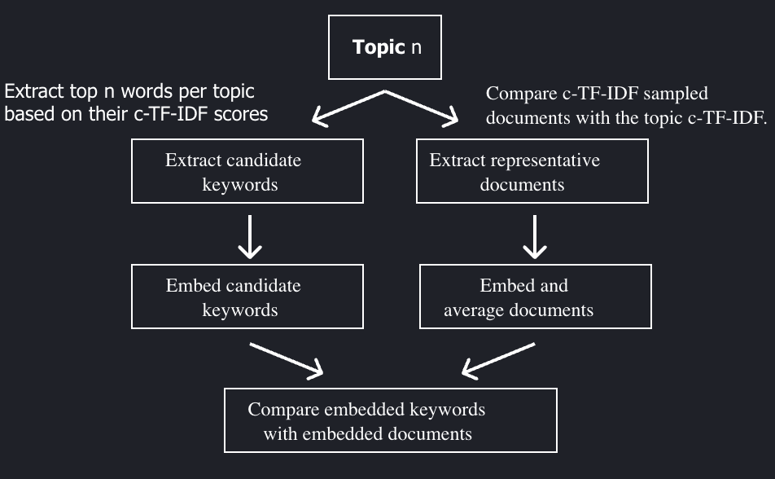
BERTopic: KeyBERTInspired
Notes:
I used KeyBertInspired representation model, which takes in the results from c-tf-idf model as suggestion to generate final representation of each topic.

Slide 28
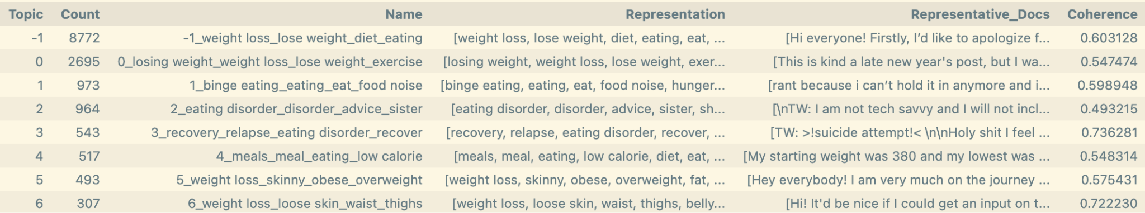
BERTopic: Result
Average Coherence Score: 0.603128
Much Higher than LDA results!
Notes:
The above implementation yields an average coherence score of 0.6 with 7 topics, which is much higher than all LDA results we get

Slide 29
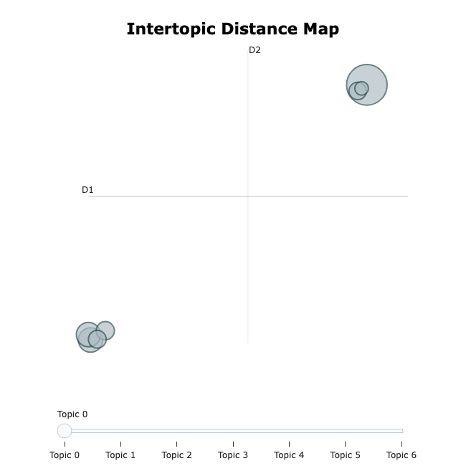
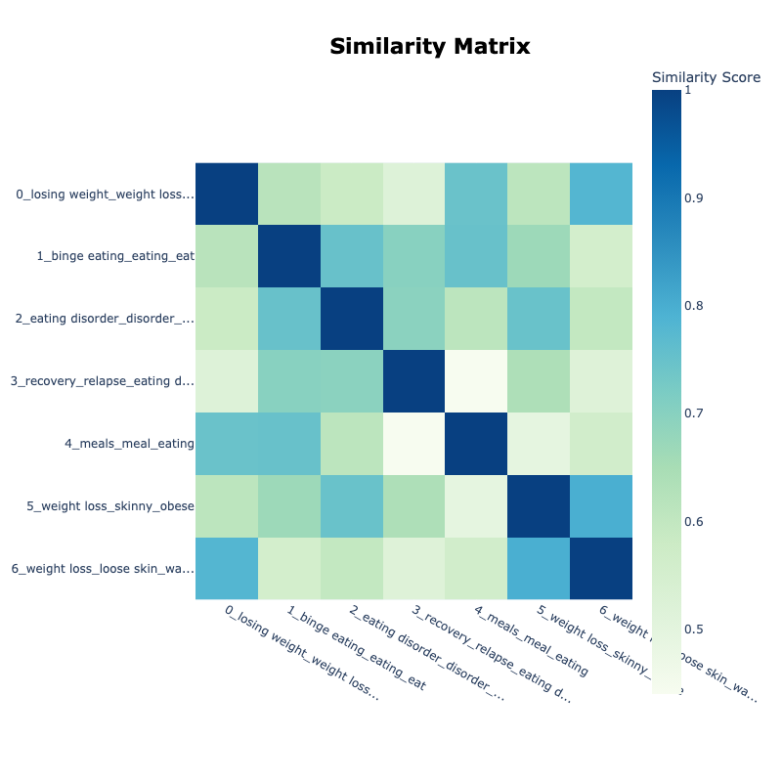
BERTopic: Viz & Interpretation
Notes:
We can see there is distinct separation between two larger categories of topics. The similarity matrix is consistent with our observation. Topic 0, 4, 6 are more similar to each other as they overlap more.

Slide 30
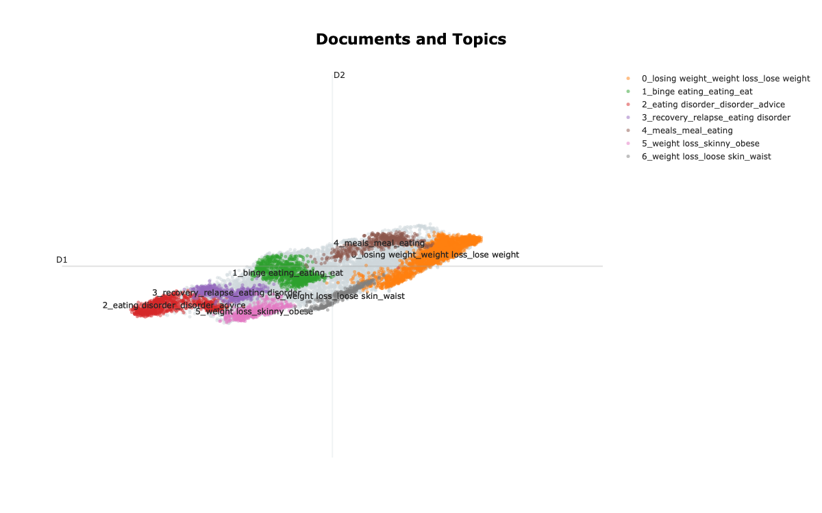
BERTopic: Viz & Interpretation
Notes:
We see distinct color clusters. Note the grey points represent documents that are not identified as any of the 7 topics.

Slide 31
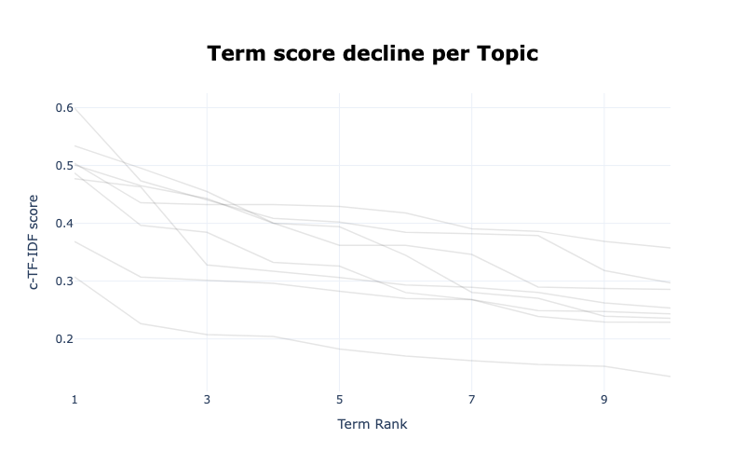
BERTopic: Viz & Interpretation
Notes:
I also plot the term score decline per topic. Note the lowest line corresponds to the topic with lowest coherence.

Slide 32
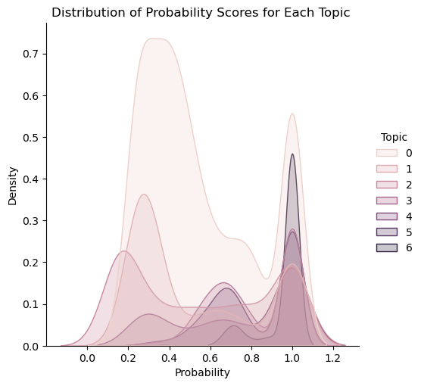
BERTopic: Viz & Interpretation
Notes:
We can plot the distribution of probability scores for each topic.
Topics 5 and 6 are the most confidently assigned, meaning they have a well-clustered and distinct set of documents.
The multi-modal distributions of some topics indicate that some documents belong to them weakly, while others are strong matches.

Slide 33
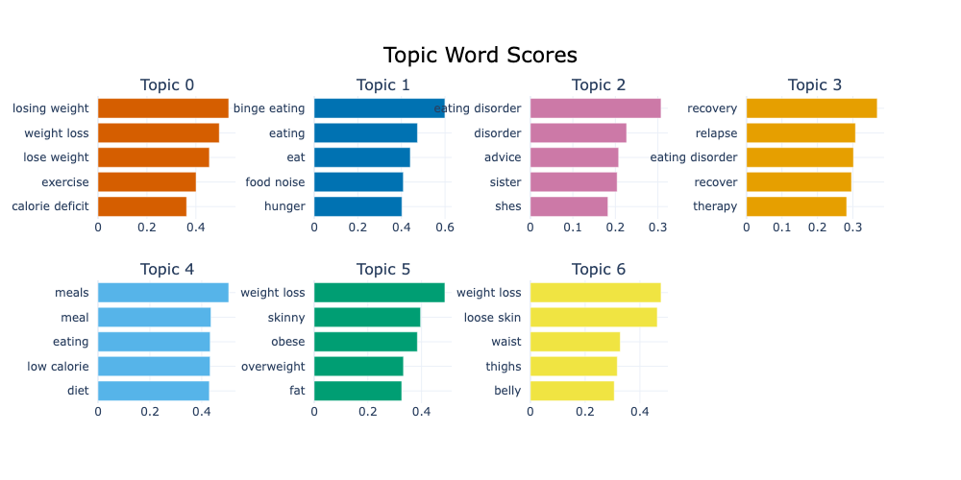
BERTopic: Viz & Interpretation
Notes:
I summarized the themes for each topic.
**Topic 0:** Weight Loss & Exercise
**Topic 1:** Binge Eating & Food-Related Behaviors
**Topic 2:** Eating Disorders & Family Relationships
**Topic 3:** Recovery & Treatment for Eating Disorders
**Topic 4:** Dieting, Meal Planning, & Low-Calorie Foods
**Topic 5:** Weight Perception & Body Image
**Topic 6:** Weight Loss & Body Changes

Slide 34
BERTopic: Ambiguous Clustering Example
Topic 1: Binge Eating & Food-Related Behaviors
--------------------
Example:
Text: I always wanted to have a cat since I was a child. I’m considering (finally with my mother’s approval) adopting one because I feel like it could literally change my life to have someone to take care of and who make me happy.
I think I could avoid many extreme binge days too if I had an excuse to go out or play.
Probability: 1.0
--------------------
Notes:
I randomly samples three posts for each topic to examine whether they are consistent with the topic assignment. I spot the following three ambiguous examples.
This example from topic 1 is more focused on cat adoption, which the user believe should help them recover from eating disorder. Could be in -1 unclustered or topic 3 about recovery

Slide 35
BERTopic: Ambiguous Clustering Example
Topic 4: Dieting, Meal Planning, & Low-Calorie Foods
--------------------
Example:
Text:
Going to a Chinese restaurant today and I want to challenge myself. I've already decided I'll order fried rice, and I want to order a less 'healthy' option. I'm thinking sweet and sour as I loved it as a kid, but battered food kinda scares me... What should I order? I don't want to eat nothing but I feel the need to challenge myself. It's my birthday and it'd be a great present to myself if I could manage something like this.
Probability: 1.0
--------------------
Notes:
This example from topic 4 ask for suggestions on food choice. However, the underlying tone implicates the person struggles with restrictive eating behavior.

Slide 36
BERTopic: Ambiguous Clustering Example
Topic 5: Weight Perception & Body Image
--------------------
Example:
Text: Not in a sense of like, trying to hide your funkiness per se. I straight up do not want people to notice weight I've lost after I've lost it for example. I don't want people to notice my eating habits. I don't want comments about it, or me, at all.
I feel like it really isn't their business and that kind of interpersonal vulnerability is frankly terrifying. Besides, I am downright embarrassed as fuck about this.
This has manifested in some shit. Like, I go for walks either in the wee hours of the morning or late at night, when very few people are out. Pretty much the only thing that stalls my compulsion towards exercise seems to be the prospect of running into somebody I know and having to explain myself (even though like, I'm just going on a walk from their perspective, right?)
Simultaneously, I would like to be able to talk about it with *someone*. So it is really weird that while I would like to talk about it, I would not want anyone to know.
Probability: 0.6195811864492295
--------------------
Notes:
This example focuses more on feelings one experience while trying to lose weight. Hence, we could also argue that it should belong to Topic 3.

Slide 37
BERTopic: Reflection
Overall, BERTopic produces topic clustering with higher coherence and the randomly sampled posts are mostly consistent with their clustering. It will be interesting to explore how the topics generated by BERTopic model can be used for labeling and semi-supervised machine learning classification tasks. In addition, if further parameter tuning are conducted for each sub models in BERTopic model, we may have even better results.

Slide 38
Model Comparison
Performance: BERTopic > LDA:
1. uses embeddings to capture more semantic information;
2. does not force data to be clustered into one topic, allowing outliers to exist.
LDA’s Advantages:
easier to get more detailed information about the patterns of token distribution in each topic.
Computation Speed:
LDA: strongly correlated with the text preprocessing techniques
BERTopic: relies on transformer-based embeddings, which can be slower + benefits from more efficient topic discovery due to its clustering-based approach
Notes:
For our dataset, BERTopic yields better performance than LDA models as it uses embeddings to capture more semantic information and does not force data to be clustered into one topic, allowing outliers to exist. Hence, the quality of the topics produced by BERTopic is higher.
LDA models also have its advantages. It is easier to get more detailed information about the patterns of token distribution in each topic. This advantage is important in interpreting the results of topic modeling.
In terms of computation speed, LDA's iterative nature and its reliance on fitting a fixed number of topics make it computationally more expensive when working with large datasets.
Bertopic is a better choice for my project as the data is unstructured and contains a significant amount of complex language.

Slide 39
References
[Sentence Transformer Documentation]
[UMAP Documentation]
[HDBSCAN Documentation]
[Class-Based TF-IDF]
[NLTK Tutorial]
[Multi-Sentiment Analysis Model]
[LDA Tutorial]
[LDA Tutorial 2]
[LDA Evaluation Tutorial]
[LDA Visualization Tutorial]
[BERTopic Algorithm]
[BERTopic Starter Tutorial]
[BERtopic Tutorial]

